Slide 1
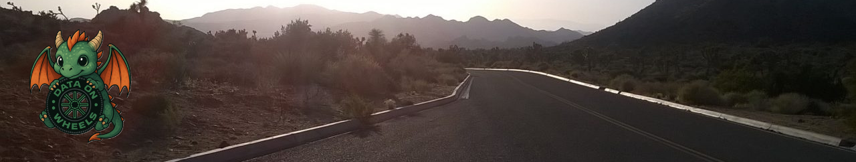
Mastering the Content Snowball Turning Tiny Efforts into Big Opportunities
Kristyna Ferris
Fun Fact: this font is dyslexic friendly! Ask me how to use it for free after the session.
Notes:
Open-Dyslexic Font | dafont.com
Download the font from Open-Dyslexic Font | dafont.com
Extract the files
Go to computer settings > personalization > fonts and drop in the files
Navigate to Power Point Master Slide
Change the font to use Open Dyslexic for the headers and body
Done!

Slide 2

About Me ~ Kristyna Ferris
Microsoft MVP, Data Platform & Fabric Solution Architect, P3 Adaptive Lexington Data Tech Group co-organizer DataOnWheels Author
Blog
https://dataonwheels.wordpress.com/ LinkedIn
https://www.linkedin.com/in/kristyna-ferris-dataonwheels/
Twitter & Bluesky
@data_dragoness

Slide 3

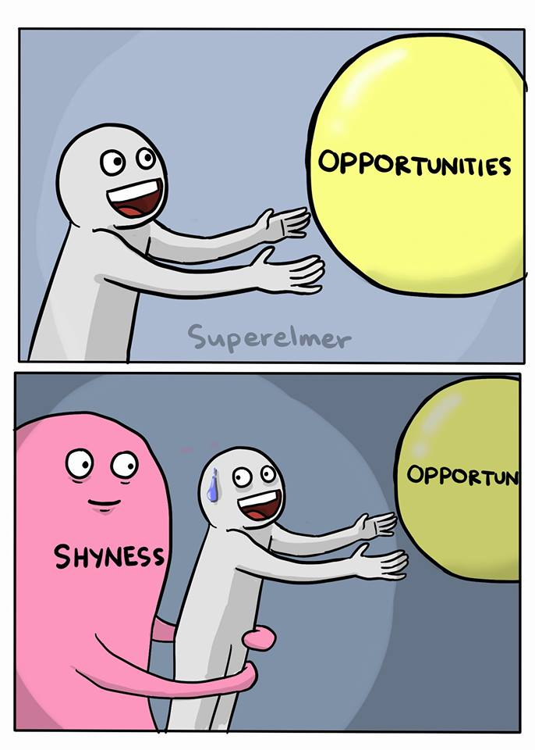
Why Should I Speak/Blog?
Opportunities Abound
Jobs
Collaborations
Speaking Invites
Travel

Slide 4
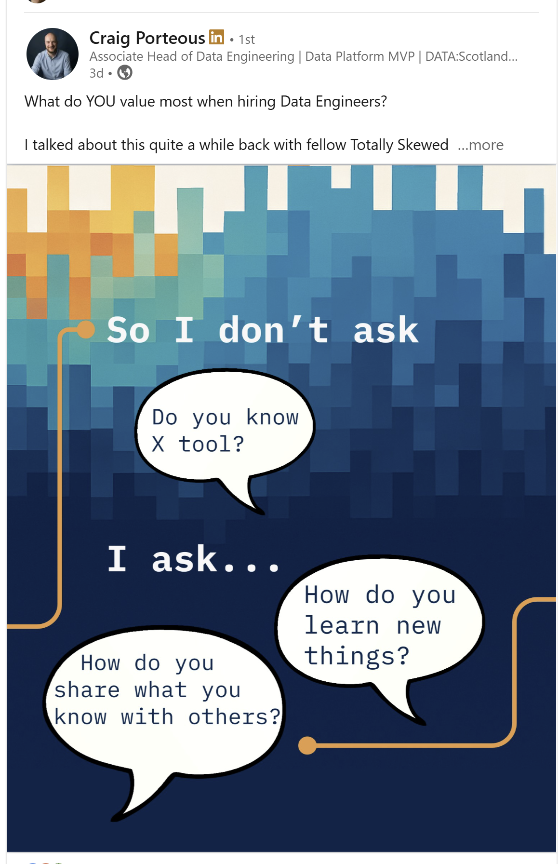
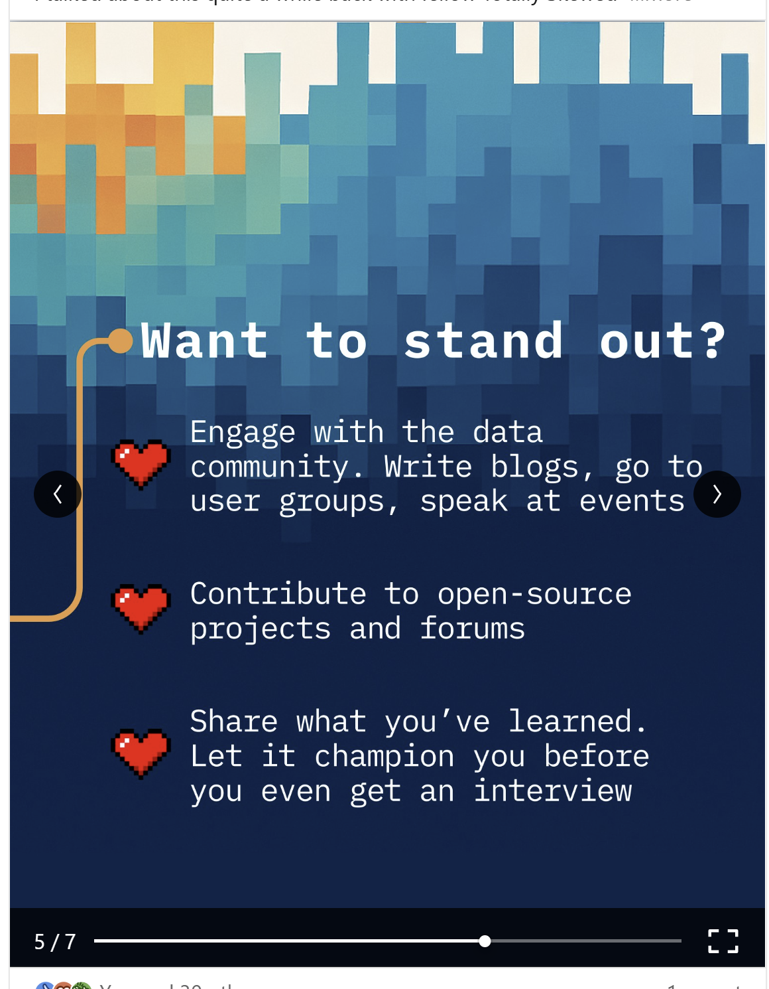
Why Should I Speak/Blog?
Notes:
https://www.linkedin.com/posts/craigporteous_what-i-look-for-when-hiring-a-data-engineer-ugcPost-7369659413004967936-6JsQ?utm_source=share&utm_medium=member_desktop&rcm=ACoAAB5kqf8BO_13s2ln_QI2RcuKscj4__ibJd4

Slide 5


What is holding you back?
Imposter Syndrome?
Perfectionism?
Time?
Fear of Failure?
How can we overcome these?

Slide 6


Stock Your Toolbelt
Create your own brand!
Tiny Topic Picker
Content Snowball
LEGO Method

Slide 7

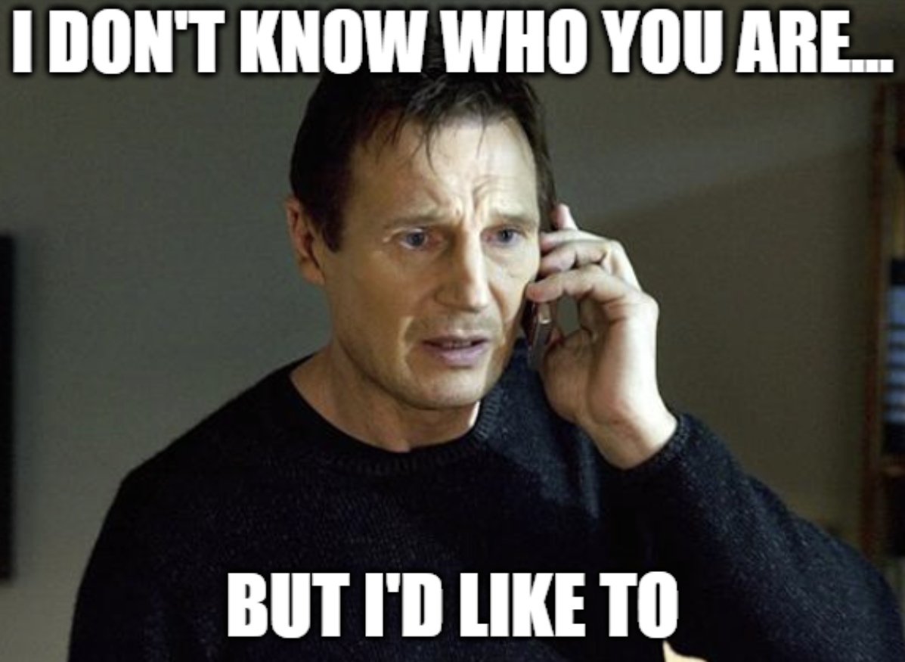
Create YOUR Brand!
Pick something that brings you joy
Stuck? Think of an icon/image that you would want on a sticker. Now tie it to data!
Blocker – fear of picking the wrong thing
Breaker – the key is to pick something with alliteration or puns, data related, and SFW. If your idea has all of these, it’s a winner!
Notes:
This is something that can really help when you have issues with getting off the blank page. It can also help you grow so people know who you are and how to find you. It can be something serious or silly, but it needs to be yours.

Slide 8


The Tiny Topic Picker
Pick ONE narrow theme (one bug fixed, one viz improved, one SQL pattern) and build a backlog so you never face a blank page
DO NOT OVERTHINK IT
This is meant to be word vomitty and imperfect
This is the foundation for the Content Snowball

Slide 9


The Content Snowball
Maximum 30 minute-per-week to turn
Tiny Topics
Today I Learned Notes
Quick Fixes
Small Demos
Into Big Opportunities
Blogs
Sessions
Collaborations
Visibility
Notes:
Helps avoid the perfectionism problem – doesn’t need to be perfect, just needs to be written down.
Tackles the topic picker problem – generates a list of things you can be confident about.
Tell story about warehouse management failure becoming one of my best sessions

Slide 10

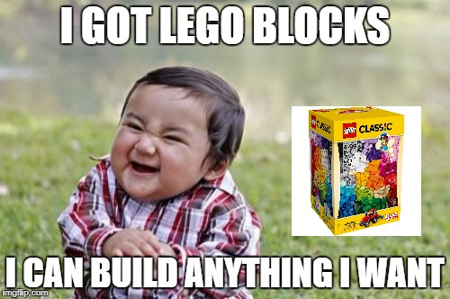
The LEGO Method
Now that you have a backlog, let’s make each Tiny Topic mighty!
Each Tiny Topic has the capacity to become a quick blog, a lightning talk, a meetup session, or a full conference session.
Don’t miss an opportunity to capitalize on your expertise.
Sit down regularly to identify what type of block your Tiny Topics are.

Slide 11


Exercise Time!
Write down 1 tiny topic
List 5 bullet points about the topic
And…that’s it! Now let’s get a content snowball rolling and make this work for us!

Slide 12


Blogging – Free(ish) Options
WordPress
WIX
Blogger

Slide 13

Blogging – Strategies
Drafts = Tiny Topic housing
Length can be highly variable. Don’t be a cooking blog, get right to the point and crack jokes along the way.
Use this as a landing page for your brand. Don’t be afraid to change it up occasionally.

Slide 14

Blogging – DEMO!

Slide 15

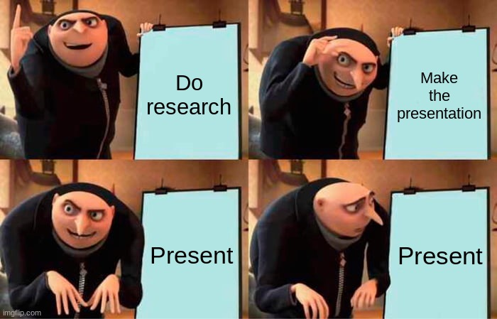
Speaking – Use Sessionize & GitHub
Start rolling that Content Snowball!
Blog draft = session draft
Use Sessionize to document sessions and submit to events nearby
Post your content on GitHub for people to find later

Slide 16

Speaking – Accessibility Strategies
Presenting – keep backgrounds light and text dark
Use easy to read fonts and sizes
Use ZoomIt.exe to make demos engaging and readable
Notes:
ZoomIt - Sysinternals | Microsoft Learn

Slide 17
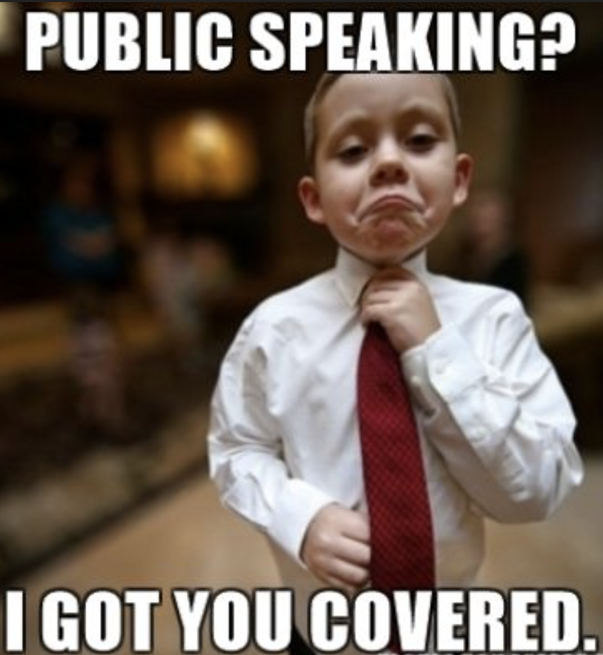
Speaking – Talking Strategies
Use talking scaffolds Problem > Path > Payoff
Tell a story or two
Leave time for questions (don’t be afraid, they are a good sign)
Get excited!
Don’t worry if someone walks out, it happens and it’s scary but it’s more than survivable

Slide 18

Speaking – Talking Strategies Continued
Wear comfy shoes and something you won’t fidget with when you’re nervous
Know yourself – do you get sweaty when nervous? Anxious pacing? Dry mouth? Prep for that feeling
Being nervous is a good sign
Never forget your laptop charger and adapters if needed

Slide 19
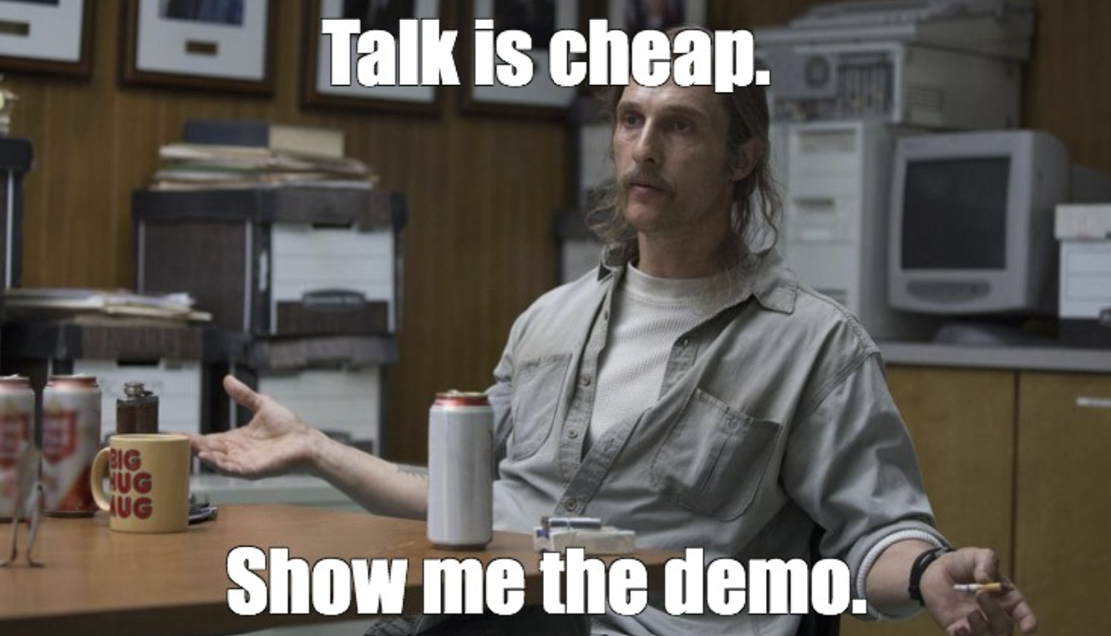
Speaking – DEMO!

Slide 20


Sneaky Success Killers
Getting buried in the views/attendees
Trying to sound like someone else
Waiting for perfect
Focusing too much on tools rather than problems
Fear of criticism

Slide 21

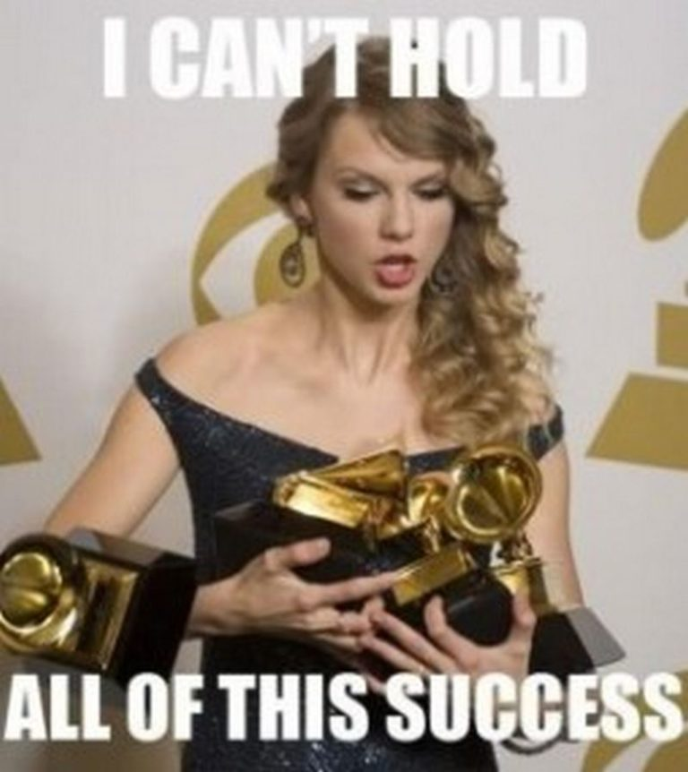
Tracking Success Successfully
Key Metrics:
Consistency
Submissions
New Connections
Posts/Month
Submissions/Year

Slide 22
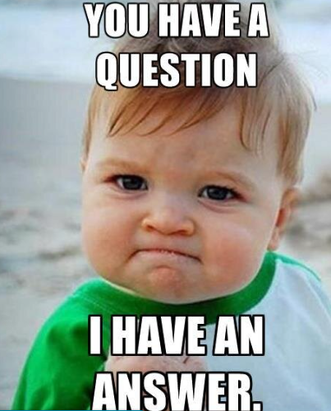
Questions?

Slide 23
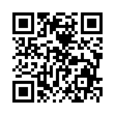
Don’t forget to connect, thanks for listening!
https://dataonwheels.wordpress.com/
kristyna@dataonwheels.com
@data_dragoness
GitHub

